Slide 1
Introduction to
IT Project Management
Dr. Dr. Alshaimaa Ramdan
Teaching Assistant:
Rana Alaaeldin
Salwa Megahed
Sherrie Kareem
Spring Semester 2019
IT Project Management-Tutorial 2

Slide 2


Activity
Read the 2 cases
“SAP” & “FBI”
IT Project Management-Tutorial 2

Slide 3
Activity
Discussion
Identify the project.
Why did they fail? Mention the failure factors
IT Project Management-Tutorial 2

Slide 4
Activity
Discussion
Identify the project.
Why did they succeed? Mention the success factors
IT Project Management-Tutorial 2

Slide 5
Why IT projects succeed?
Success factors:
1. User involvement
2. Executive support
3. Clear business objectives
4. Emotional maturity
5. Optimizing scope
6. Agile process
7. Project management expertise
8. Skilled resources
9. Execution
10. Tools and infrastructure
IT Project Management-Tutorial 2

Slide 6
Why IT projects fail?
Failure factors:
Poor planning
Unclear goals and objectives
Objectives changing during the project
Unrealistic time or resource estimates
Lack of executive support and user involvement
Failure to communicate and act as a team
Inappropriate skills
IT Project Management-Tutorial 2

Slide 7
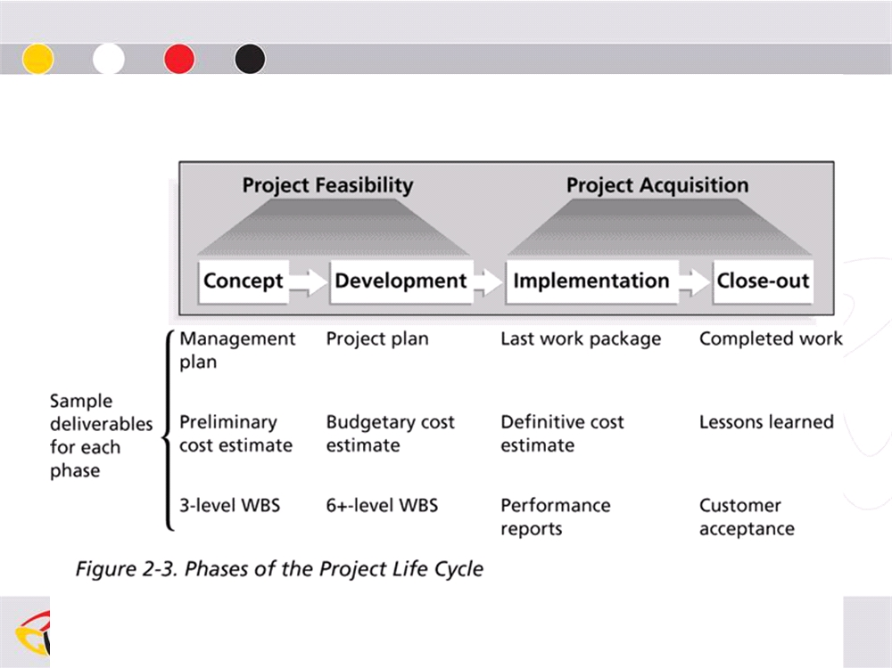
Project Life cycle
Project Lifecycle
IT Project Management-Tutorial 2

Slide 8
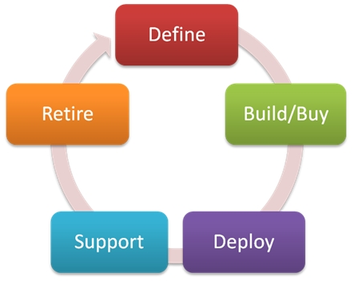
Product Life cycle
Product Lifecycle
IT Project Management-Tutorial 2

Slide 9
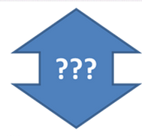
Relationship
Project Lifecycle VS Product Lifecycle
IT Project Management-Tutorial 2

Slide 10
Next Time in the Lab !!
IT Project Management-Tutorial 2

